Slide 1
Cryptography and Network Security
Chapter 19
Fourth Edition
by William Stallings
Lecture slides by Lawrie Brown
Notes:
Lecture slides by Lawrie Brown for “Cryptography and Network Security”, 4/e, by William Stallings, Chapter 19 – “Malicious Software”.

Slide 2
Chapter 19 – Malicious Software
What is the concept of defense: The parrying of a blow. What is its characteristic feature: Awaiting the blow.
—On War, Carl Von Clausewitz
Notes:
Opening quote.

Slide 3
Viruses and Other Malicious Content
computer viruses have got a lot of publicity
one of a family of malicious software
effects usually obvious
have figured in news reports, fiction, movies (often exaggerated)
getting more attention than deserve
are a concern though
Notes:
This chapter examines malicious software (malware), especially viruses and worms, which exploit vulnerabilities in computing systems. These have been given a lot of (often uninformed) comment in the general media. They are however, of serious concern.

Slide 4
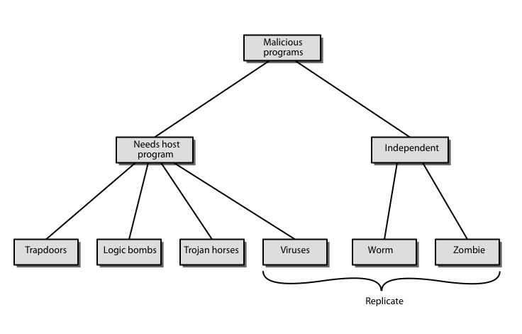
Malicious Software
Notes:
The terminology used for malicious software presents problems because of a lack of universal agreement on all terms and because of overlap. Stallings Table 19.1, and this diagram from 3/e, provide a useful taxonomy. It can be divided into two categories: those that need a host program (being a program fragment eg virus), and those that are independent programs (eg worm); alternatively you can also differentiate between those software threats that do not replicate (are activated by a trigger) and those that do (producing copies of themselves). Will now survey this range of malware.

Slide 5
Backdoor or Trapdoor
secret entry point into a program
allows those who know access bypassing usual security procedures
have been commonly used by developers
a threat when left in production programs allowing exploited by attackers
very hard to block in O/S
requires good s/w development & update
Notes:
A backdoor, or trapdoor, is a secret entry point into a program that allows someone that is aware of it to gain access without going through the usual security access procedures. Have been used legitimately for many years to debug and test programs, but become a threat when left in production programs. It is difficult to implement operating system controls for backdoors. Security measures must focus on the program development and software update activities.

Slide 6
Logic Bomb
one of oldest types of malicious software
code embedded in legitimate program
activated when specified conditions met
  eg presence/absence of some file
  particular date/time
  particular user
when triggered typically damage system
  modify/delete files/disks, halt machine, etc
Notes:
A logic bomb is one of the oldest types of program threat, being code embedded in some legitimate program that is set to “explode” when certain conditions, such as the examples shown, are met. Once triggered, a bomb may alter or delete data or entire files, cause a machine halt, or do some other damage.

Slide 7
Trojan Horse
program with hidden side-effects
which is usually superficially attractive
  eg game, s/w upgrade etc
when run performs some additional tasks
  allows attacker to indirectly gain access they do not have directly
often used to propagate a virus/worm or install a backdoor
or simply to destroy data
Notes:
A Trojan horse is a useful, or apparently useful, program or command procedure (eg game, utility, s/w upgrade etc) containing hidden code that performs some unwanted or harmful function that an unauthorized user could not accomplish directly. Commonly used to make files readable, propagate a virus or worm, or simply to destroy data.

Slide 8
Zombie
program which secretly takes over another networked computer
then uses it to indirectly launch attacks
often used to launch distributed denial of service (DDoS) attacks
exploits known flaws in network systems
Notes:
A zombie is a program that secretly takes over another Internet-attached computer and then uses that computer to launch attacks that are difficult to trace to the zombie’s creator. Zombies are used in denial-of-service attacks, being planted on hundreds of computers belonging to unsuspecting third parties, and then used to overwhelm the target Web site by launching an overwhelming onslaught of Internet traffic. Typically zombies exploit known flaws in networked computer systems.

Slide 9
Viruses
a piece of self-replicating code attached to some other code
  cf biological virus
both propagates itself & carries a payload
  carries code to make copies of itself
  as well as code to perform some covert task
Notes:
A virus is a piece of software that can “infect” other programs by modifying them; the modification includes a copy of the virus program, which can then go on to infect other programs. It can be compared to biological viruses, and like them, a computer virus carries in its instructional code the recipe for making perfect copies of itself. Once a virus is executing, it can perform any function, such as erasing files and programs.

Slide 10
Virus Operation
virus phases:
  dormant – waiting on trigger event
  propagation – replicating to programs/disks
  triggering – by event to execute payload
  execution – of payload
details usually machine/OS specific
  exploiting features/weaknesses
Notes:
During its lifetime, a typical virus goes through the following four phases:
• Dormant phase: virus is idle, waiting for trigger event (eg date, program or file , disk capacity). Not all viruses have this stage
• Propagation phase: virus places a copy of itself into other programs / system areas
• Triggering phase: virus is activated by some trigger event to perform intended function
• Execution phase: desired function (which may be harmless or destructive) is performed
Most viruses work in a manner specific to a particular operating system or even hardware platform, and are designed to take advantage of the details and weaknesses of particular systems.

Slide 11
Virus Structure
program V :=
{goto main;
1234567;
subroutine infect-executable := {loop:
file := get-random-executable-file;
if (first-line-of-file = 1234567) then goto loop
else prepend V to file; }
subroutine do-damage := {whatever damage is to be done}
subroutine trigger-pulled := {return true if condition holds}
main: main-program := {infect-executable;
if trigger-pulled then do-damage;
goto next;}
next:
}
Notes:
Stallings Figure 19.1 shows a general depiction of virus structure. The virus code (V) is prepended to infected programs (assuming the entry point is the first line of the program). The first line of code jumps to the main virus program. The second line is a special marker for infected programs. The main virus program first seeks out uninfected executable files and infects them. Then it may perform some action, usually detrimental to the system, depending on some trigger. Finally, the virus transfers control to the original program. If the infection phase of the program is reasonably rapid, a user is unlikely to notice any difference between the execution of an infected and uninfected program. This type of virus can be detected because the length of the program changes. More sophisticated variants attempt to hide their presence better, by for example, compressing the original program.

Slide 12
Types of Viruses
can classify on basis of how they attack
parasitic virus
memory-resident virus
boot sector virus
stealth
polymorphic virus
metamorphic virus
Notes:
There has been a continuous arms race between virus writers and writers of antivirus software, with the following categories being among the most significant types of viruses:
• Parasitic virus: traditional and still most common form of virus, it attaches itself to executable files and replicates when the infected program is executed
• Memory-resident virus: Lodges in main memory as part of a resident system program, and infects every program that executes
• Boot sector virus: Infects a master boot record and spreads when a system is booted from the disk containing the virus
• Stealth virus: a virus explicitly designed to hide itself from detection by antivirus software
• Polymorphic virus: mutates with every infection, making detection by the “signature”of the virus impossible.
• Metamorphic virus: mutates with every infection, rewriting itself completely at each iteration changing behavior and/or appearance, increasing the difficulty of detection.

Slide 13
Macro Virus
macro code attached to some data file
interpreted by program using file
  eg Word/Excel macros
  esp. using auto command & command macros
code is now platform independent
is a major source of new viral infections
blur distinction between data and program files
classic trade-off: "ease of use" vs "security”
have improving security in Word etc
are no longer dominant virus threat
Notes:
In the mid-1990s, macro viruses became by far the most prevalent type of virus, and were particularly threatening because they’re platform independent, infect documents not executable code, and are easily spread. Macro viruses take advantage of the macro feature found in Word and other office applications. A macro is an executable program embedded in a word processing document or other type of file, blurring distinction between document & program. There is a continuing arms race in the field of macro viruses. Successive releases of Word provide increased protection against macro viruses, and they no longer are the predominant virus threat.

Slide 14
Email Virus
spread using email with attachment containing a macro virus
  cf Melissa
triggered when user opens attachment
or worse even when mail viewed by using scripting features in mail agent
hence propagate very quickly
usually targeted at Microsoft Outlook mail agent & Word/Excel documents
need better O/S & application security
Notes:
A more recent development in malicious software is the e-mail virus. The first rapidly spreading e-mail viruses, such as Melissa, made use of a Microsoft Word macro embedded in an attachment, triggered when the attachment was opened. At the end of 1999, a more powerful version of the e-mail virus appeared, activated merely by opening an e-mail that contains the virus rather than opening an attachment. As a result, instead of taking months or years to propagate, now take only hours.This makes it very difficult for antivirus software to respond before much damage is done. Ultimately, a greater degree of security must be built into Internet utility and application software on PCs to counter this growing threat.

Slide 15
Worms
replicating but not infecting program
typically spreads over a network
  cf Morris Internet Worm in 1988
  led to creation of CERTs
using users distributed privileges or by exploiting system vulnerabilities
widely used by hackers to create zombie PC's, subsequently used for further attacks, esp DoS
major issue is lack of security of permanently connected systems, esp PC's
Notes:
A worm is a program that can replicate itself and send copies from computer to computer across network connections. Upon arrival, the worm may be activated to replicate and propagate again, and usually to also perform some unwanted function. A worm actively seeks out more machines to infect and each machine that is infected serves as an automated launching pad for attacks on other machines. To replicate itself, a network worm uses some sort of network vehicle such as email, remote execution, or remote login. Once active within a system, a network worm can behave as a computer virus or bacteria, or it could implant Trojan horse programs or perform any number of disruptive or destructive actions.

Slide 16
Worm Operation
worm phases like those of viruses:
  dormant
  propagation
    search for other systems to infect
    establish connection to target remote system
    replicate self onto remote system
  triggering
  execution
Notes:
A network worm exhibits the same characteristics as a computer virus: a dormant phase, a propagation phase, a triggering phase, and an execution phase. The propagation phase generally:
Searches for other systems to infect by examining host tables etc
2. Establishes a connection with a remote system
3. Copies itself to the remote system and cause the copy to be run.

Slide 17
Morris Worm
best known classic worm
released by Robert Morris in 1988
targeted Unix systems
using several propagation techniques
  simple password cracking of local pw file
  exploit bug in finger daemon
  exploit debug trapdoor in sendmail daemon
if any attack succeeds then replicated self
Notes:
Until recently, the best known was the Morris worm released onto the Internet by Robert Morris in 1998. It was designed to spread on UNIX systems and used a number of different techniques for propagation, including cracking the local password file to get logins/passwords, exploiting a bug in the finger protocol, or exploiting a trapdoor in the debug option of the sendmail mail daemon. If any attack succeeded then the worm had a means of running on another system and replicating itself.

Slide 18
Recent Worm Attacks
new spate of attacks from mid-2001
Code Red - used MS IIS bug
  probes random IPs for systems running IIS
  had trigger time for denial-of-service attack
  2nd wave infected 360000 servers in 14 hours
Code Red 2 - installed backdoor
Nimda - multiple infection mechanisms
SQL Slammer - attacked MS SQL server
Sobig.f - attacked open proxy servers
Mydoom - mass email worm + backdoor
Notes:
The contemporary era of worm threats began with the release of the Code Red worm in July of 2001.
Code Red exploited a security hole in Microsoft Internet Information Server (IIS) to penetrate and spread, & also disabled the system file checker in Windows. It probed random IP addresses to spread to other hosts, & had a trigger time for a DDoS attack. It infected nearly 360,000 servers in 14 hours, & consumed enormous amounts of Internet capacity, disrupting service.
Code Red II is a variant that installed a backdoor allowing a hacker to direct activities of victim computers.
Nimda appeared in late 2001 & spreads by multiple mechanisms: email, shares, web client, IIS, Code Red 2 backdoor. It modifies Web documents & certain executable files and creates numerous copies of itself under various filenames.
SQL Slammer worm appeared in early 2003, exploiting a buffer overflow vulnerability in Microsoft SQL server. It was extremely compact and spread rapidly, infecting 90% of vulnerable hosts within 10 minutes.
Sobig.f worm appeared in late 2003, exploiting open proxy servers to turn infected machines into spam engines. At its peak, it accounted for one in every 17 messages and produced more than one million copies of itself within the first 24 hours.
Mydoom appeared in 2004 & is a mass-mailing e-mail worm that installed a backdoor in infected computers. It replicated up to 1000 times per minute and reportedly flooded the Internet with 100 million infected messages in 36 hours.

Slide 19
Worm Techology
multiplatform
multiexploit
ultrafast spreading
polymorphic
metamorphic
transport vehicles
zero-day exploit
Notes:
The state of the art in worm technology includes the following:
• Multiplatform: not limited to Windows, can attack a variety of O/S’s, esp UNIX.
• Multiexploit: penetrate systems in a variety of ways
• Ultrafast spreading: using prior scan to get addresses of vulnerable machines
• Polymorphic: adopt virus polymorphic technique to evade detection
• Metamorphic: change both appearance & behavior patterns
• Transport vehicles: to spread other distributed attack tools, eg zombies
• Zero-day exploit: exploit unknown vulnerability

Slide 20
Virus Countermeasures
best countermeasure is prevention
but in general not possible
hence need to do one or more of:
  detection - of viruses in infected system
  identification - of specific infecting virus
  removeal - restoring system to clean state
Notes:
The ideal solution to the threat of viruses is prevention, but in general this is impossible to achieve. The next best approach is to be able to do the following:
• Detection: determine that infection has occurred and locate the virus
• Identification: of the specific virus that has infected a program
• Removal: of all traces of the virus from the infected program and restore it to its original state; or discard infected program and reload a clean backup version

Slide 21
Anti-Virus Software
first-generation
  scanner uses virus signature to identify virus
  or change in length of programs
second-generation
  uses heuristic rules to spot viral infection
  or uses crypto hash of program to spot changes
third-generation
  memory-resident programs identify virus by actions
fourth-generation
  packages with a variety of antivirus techniques
  eg scanning & activity traps, access-controls
arms race continues
Notes:
As the virus arms race has evolved,both viruses and, necessarily, antivirus software have grown more complex and sophisticated. See four generations of antivirus software:
• First generation: simple scanners use a virus signature to identify a virus, limited to known viruses; or use length of program to detect changes to it
• Second generation: heuristic scanners use rules to search for probable virus infection, eg for code fragments; or use crypto hash of programs to detect changes
• Third generation: activity traps which identify a virus by its actions rather than its structure
• Fourth generation: full-featured protection using packages consisting of a variety of antivirus techniques used in conjunction, including scanning and activity trap components
The arms race continues. With fourth-generation packages, a more comprehensive defense strategy is employed, broadening the scope of defense to more general purpose computer security measures.

Slide 22
Advanced Anti-Virus Techniques
generic decryption
  use CPU simulator to check program signature & behavior before actually running it
digital immune system (IBM)
  general purpose emulation & virus detection
  any virus entering org is captured, analyzed, detection/shielding created for it, removed
Notes:
More sophisticated antivirus approaches and products continue to appear, such as:
Generic Decryption (GD) technology enables the antivirus program to easily detect even the most complex polymorphic viruses, while maintaining fast scanning speeds, using a CPU simulator to scan program for virus signatures & to monitor its behavior before actually running it. Have issue of how long to do this for.
The Digital Immune System from IBM is a comprehensive approach to virus protection, and provides a general purpose emulation and virus-detection system. When a new virus enters an organization, the immune system automatically captures it, analyzes it, adds detection and shielding for it, removes it, and passes information about that virus to systems running IBM AntiVirus so it can be detected before it is run elsewhere.

Slide 23
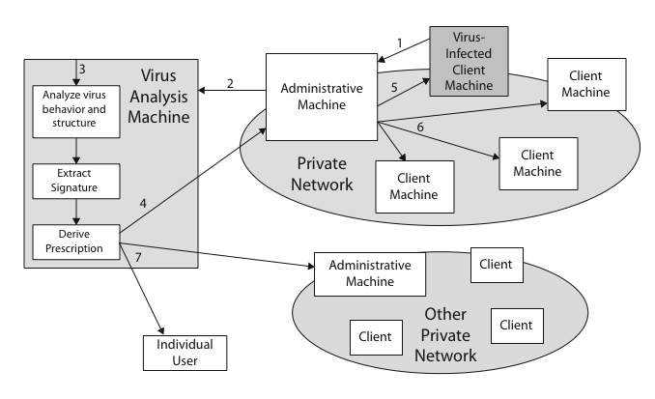
Digital Immune System
Notes:
Stallings Figure19.4 illustrates the typical steps in digital immune system operation:
A monitoring program on each PC uses a variety of heuristics based on system behavior, suspicious changes to programs, or family signature to infer that a virus may be present, & forwards infected programs to an administrative machine
2. The administrative machine encrypts the sample and sends it to a central virus analysis machine
3. This machine creates an environment in which the infected program can be safely run for analysis to produces a prescription for identifying and removing the virus
4. The resulting prescription is sent back to the administrative machine
5. The administrative machine forwards the prescription to the infected client
6. The prescription is also forwarded to other clients in the organization
7. Subscribers around the world receive regular antivirus updates that protect them from the new virus.

Slide 24
Behavior-Blocking Software
integrated with host O/S
monitors program behavior in real-time
  eg file access, disk format, executable mods, system settings changes, network access
for possibly malicious actions
  if detected can block, terminate, or seek ok
has advantage over scanners
but malicious code runs before detection
Notes:
Behavior-blocking software integrates with the operating system of a host computer and monitors program behavior in real-time for malicious actions. & blocks potentially malicious actions before they have a chance to affect the system. Monitored behaviors can include the following:
• Attempts to open, view, delete, and/or modify files
• Attempts to format disk drives and other unrecoverable disk operations
• Modifications to the logic of executable files or macros
• Modification of critical system settings,such as start-up settings
• Scripting of e-mail and instant messaging clients to send executable content
• Initiation of network communications.
If the behavior blocker detects that a program is initiating would-be malicious behaviors as it runs, it can block these behaviors in real-time and/or terminate the offending software.
The behavior blocker has a fundamental advantage over such established antivirus detection techniques since it can intercept all suspicious requests, & can identify and block malicious actions regardless of how obfuscated the program logic appears to be. But this does mean the malicious code must actually run on the target machine before all its behaviors can be identified.

Slide 25
Distributed Denial of Service Attacks (DDoS)
Distributed Denial of Service (DDoS) attacks form a significant security threat
making networked systems unavailable
by flooding with useless traffic
using large numbers of “zombies”
growing sophistication of attacks
defense technologies struggling to cope
Notes:
Distributed denial of service (DDoS) attacks present a significant security threat to corporations, and the threat appears to be growing. DDoS attacks make computer systems inaccessible by flooding servers, networks, or even end user systems with useless traffic so that legitimate users can no longer gain access to those resources. In a typical DDoS attack, a large number of compromised (zombie) hosts are amassed to send useless packets. In recent years, the attack methods and tools have become more sophisticated, effective, and more difficult to trace to the real attackers, while defense technologies have been unable to withstand large-scale attacks.

Slide 26
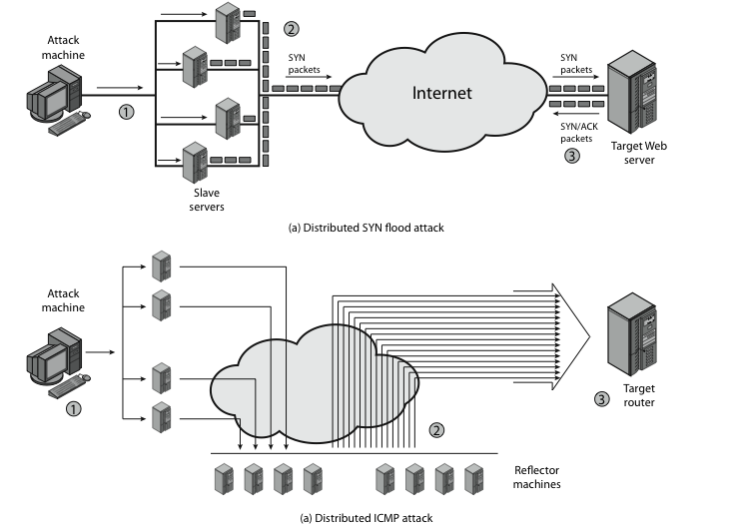
Distributed Denial of Service Attacks (DDoS)
Notes:
A DDoS attack attempts to consume the target’s resources so that it cannot provide service. One way to classify DDoS attacks is in terms of the type of resource that is consumed, either an internal host resource on the target system, or data transmission capacity in the target local network.
Stallings Figure19.5a shows an example of an internal resource attack - the SYN flood attack. 1. The attacker takes control of multiple hosts over the Internet 2. The slave hosts begin sending TCP/IP SYN (synchronize/initialization) packets, with erroneous return IP address information, to the target 3. For each such packet, the Web server responds with a SYN/ACK (synchronize/acknowledge) packet. The Web server maintains a data structure for each SYN request waiting for a response back and becomes bogged down as more traffic floods in.
Stallings Figure 19.5b illustrates an example of an attack that consumes data transmission resources. 1. The attacker takes control of multiple hosts over the Internet, instructing them to send ICMP ECHO packets with the target’s spoofed IP address to a group of hosts that act as reflectors 2. Nodes at the bounce site receive multiple spoofed requests and respond by sending echo reply packets to the target site. 3. The target’s router is flooded with packets from the bounce site, leaving no data transmission capacity for legitimate traffic.

Slide 27
Contructing the DDoS Attack Network
must infect large number of zombies
needs:
software to implement the DDoS attack
an unpatched vulnerability on many systems
scanning strategy to find vulnerable systems
  random, hit-list, topological, local subnet
Notes:
The first step in a DDoS attack is for the attacker to infect a number of machines with zombie software that will ultimately be used to carry out the attack. The essential ingredients are:
Software that can carry out the DDoS attack, runnable on a large number of machines, concealed, communicating with attacker or time-triggered, and can launch intended attack toward the target
2. A vulnerability in a large number of systems, that many system admins/users have failed to patch
3. A strategy for locating vulnerable machines, known as scanning, such as:
• Random: probe random IP addresses in the IP address space
• Hit-list: use a long list of potential vulnerable machines
• Topological: use info on infected victim machine to find more hosts
• Local subnet: look for targets in own local network

Slide 28
DDoS Countermeasures
three broad lines of defense:
  attack prevention & preemption (before)
  attack detection & filtering (during)
  attack source traceback & ident (after)
huge range of attack possibilities
hence evolving countermeasures
Notes:
Have three lines of defense against DDoS attacks:
• Attack prevention and preemption (before the attack): to enable victim to endure attack attempts without denying service to legitimate clients
• Attack detection and filtering (during the attack): to attempt to detect attack as it begins and respond immediately, minimizing impact of attack on the target
• Attack source traceback and identification (during and after the attack): to identify source of attack to prevent future attacks.
The challenge in coping with DDoS attacks is the sheer number of ways in which they can operate, hence countermeasures must evolve with the threat.

Slide 29
Summary
have considered:
  various malicious programs
  trapdoor, logic bomb, trojan horse, zombie
  viruses
  worms
  countermeasures
  distributed denial of service attacks
Notes:
Chapter 19 summary.

